Slide 1

Tower Slope Update
Parker Lewis
7/11/24

Slide 2
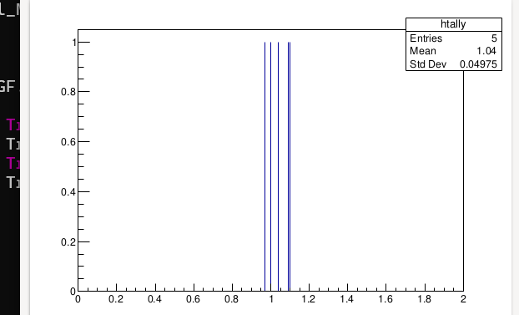
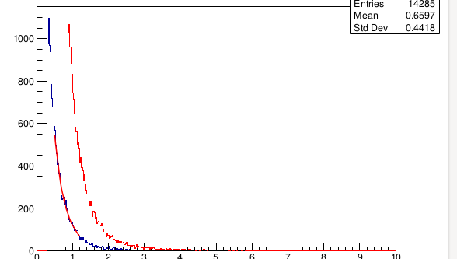
Events (n = 100,000) True Fit
SF = 1.08956
mean (H_tally) = 1.04

Slide 3
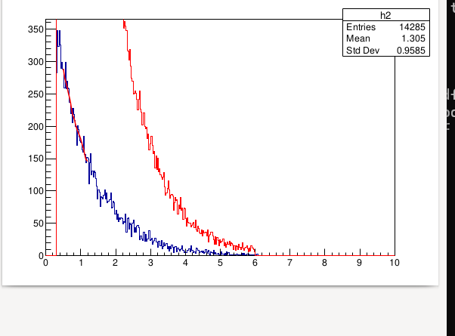
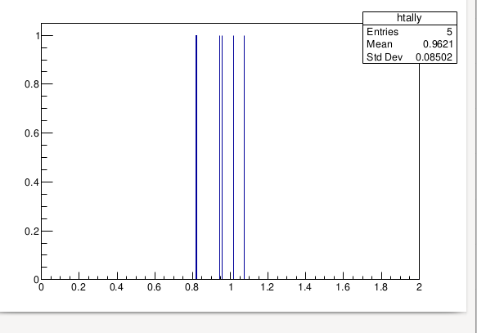
Events (n = 100,000) Exponential Fit
mean (H_tally) = 0.9621
SF = 0.95557
Test_Function: 90,000exp(-x)

Slide 4
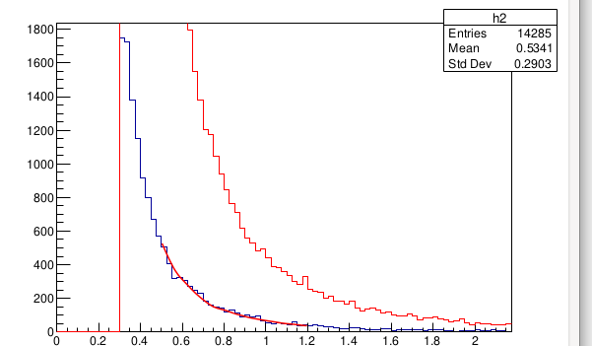
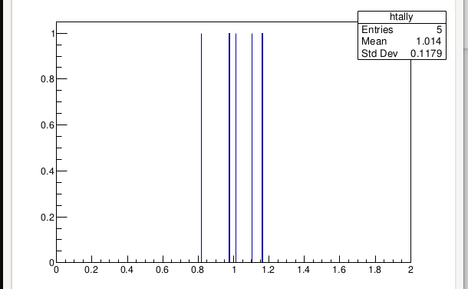
Events (n = 100,000) Poly_Decay Fit
Mean(h_tally) = 1.014
SF = 0.818179
Test_Function: 90,000x^-3

Slide 5
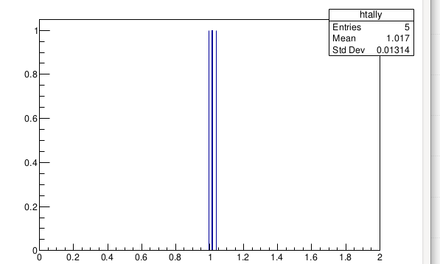
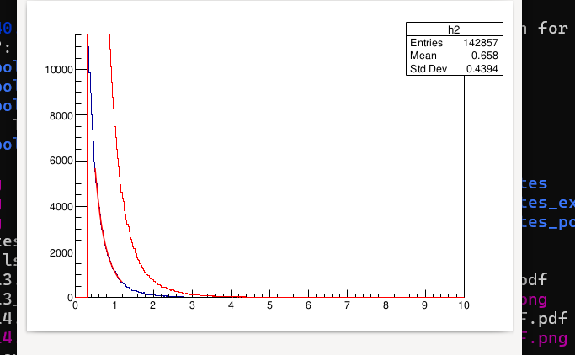
Events (n = 1e6) True Fit
Mean = 1.017
SF(ratio) = 1.03773

Slide 6
Events (n = 1e6) Exp Fit
Mean = 1.023
Ratio = 1.01617

Slide 7
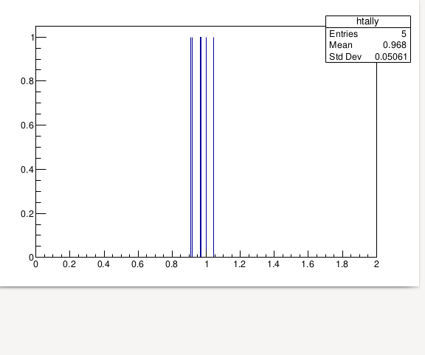
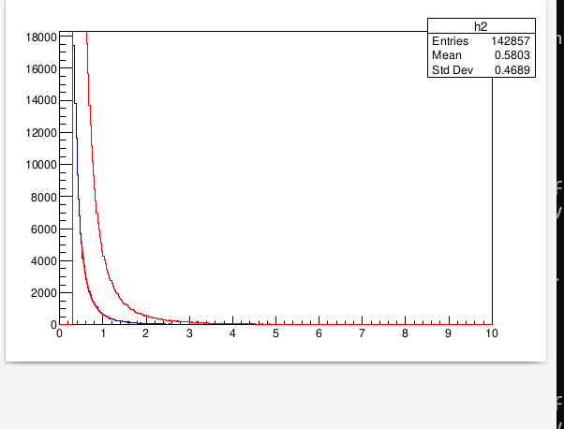
Events (n = 1e6) Poly Fit
Mean = 0.968
SF = 1.04494

Slide 8
Changing shift value 1% to 4%
The change from 1 % to 4 % shifting from the histograms h1 and h2 is a resultant of changing the Fill(GetRandom() ) from 1.015 to 1.04.
Changing the shifts also have an effect of raising what the relative calibration is, which can be useful if wanting to foreshadow based on keep changing the relative calibration knowing how and what percentage tower bins shift.

